Slide 1
Football odds
Michal Grega
IT University of copenhagen

Slide 2
Outline
Objective
Data
EDA
Feature engineering
ML/Statistical models
Splitting the data
Evaluation
Results
Discussion & conclusion
Future research suggestions

Slide 3
Objective
Performance of different machine learning methods on predicting the result of a football match
Three way/1X2 betting
Producing decimal odds
Comparison with the market
Discovering the best models
⚽

Slide 4

Data
English premier league seasons 2014-2026 (~4300 matches)
Base dataset
Target variable – FTR
Goals
Shots
Corners
Fouls
Cards

Slide 5
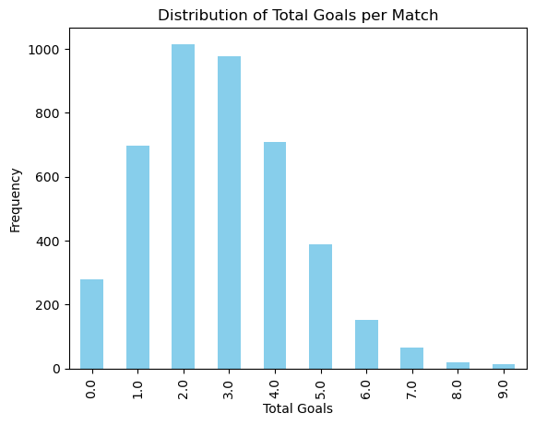
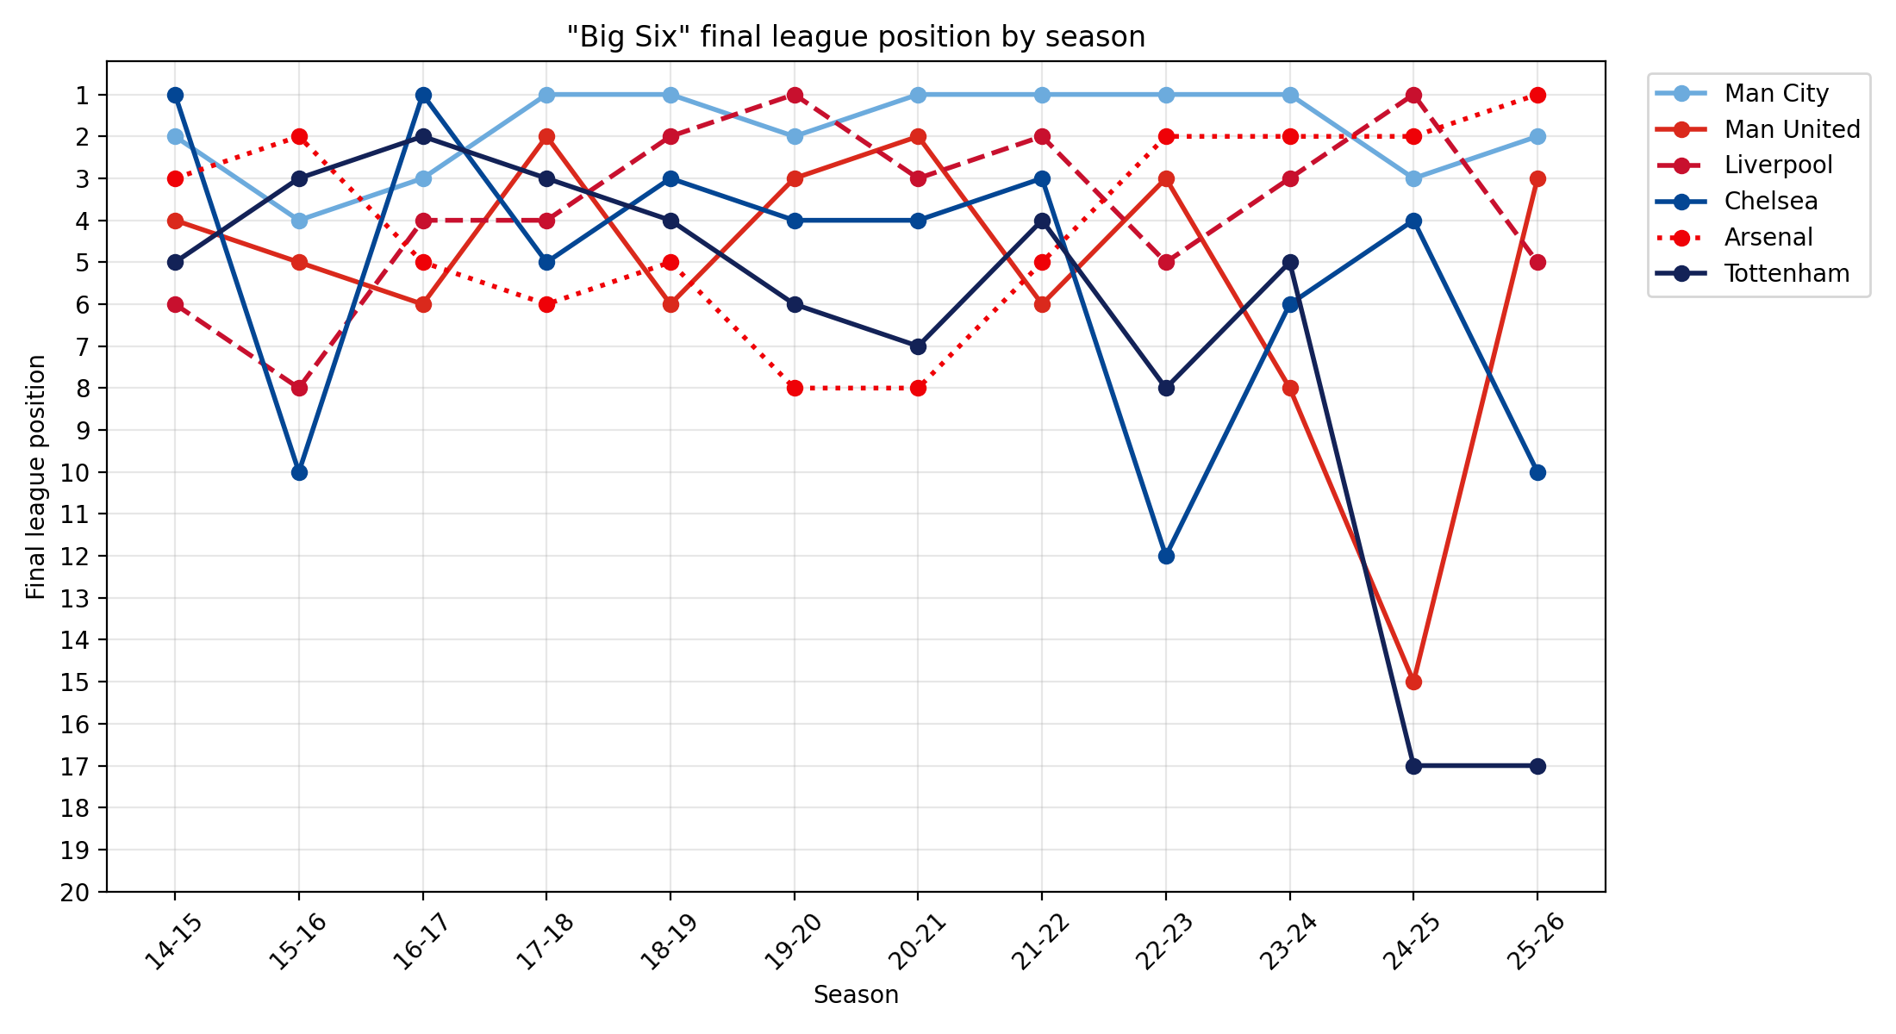
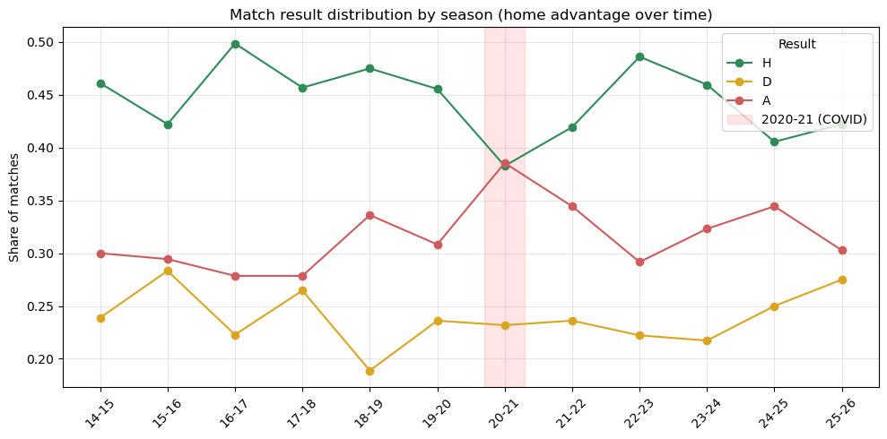
EDA
Target variable distribution
Mixed consistency
Goals count
Variance in data

Slide 6
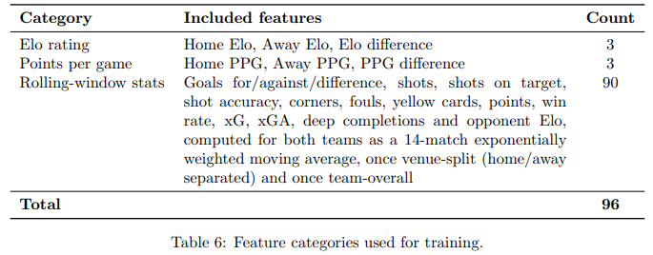
Feature engineering
Feature importance
Feature selection
Richer information
xG
Elo
Ppg
EWMA

Slide 7
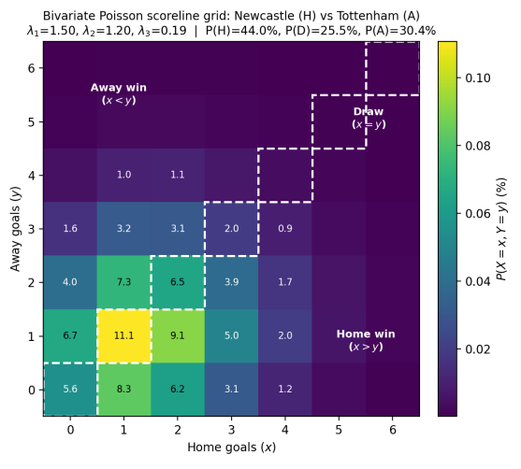
Models
Generative
Poisson regression
  Dixon-Coles
  Dixon-Coles with covariates
  Bivariate Poisson with covariates
Discriminative
Ensemble
Logistic regression
SVM
FFNN

Slide 8
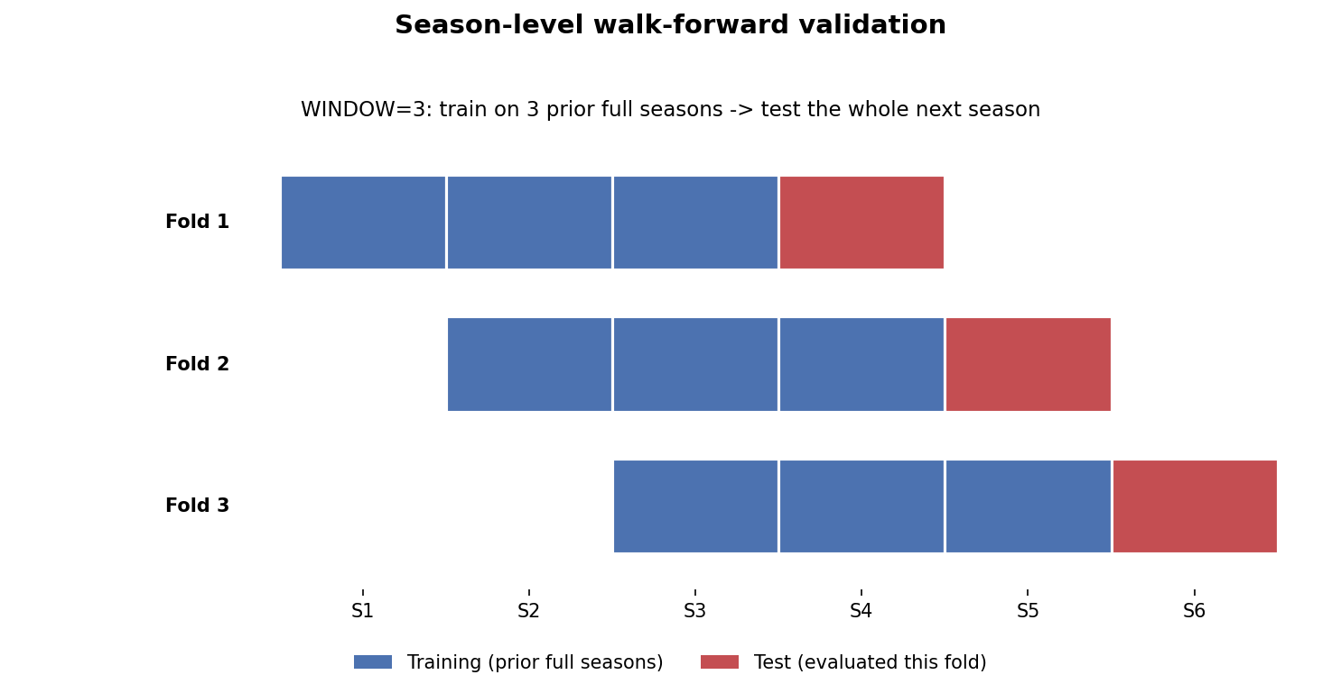
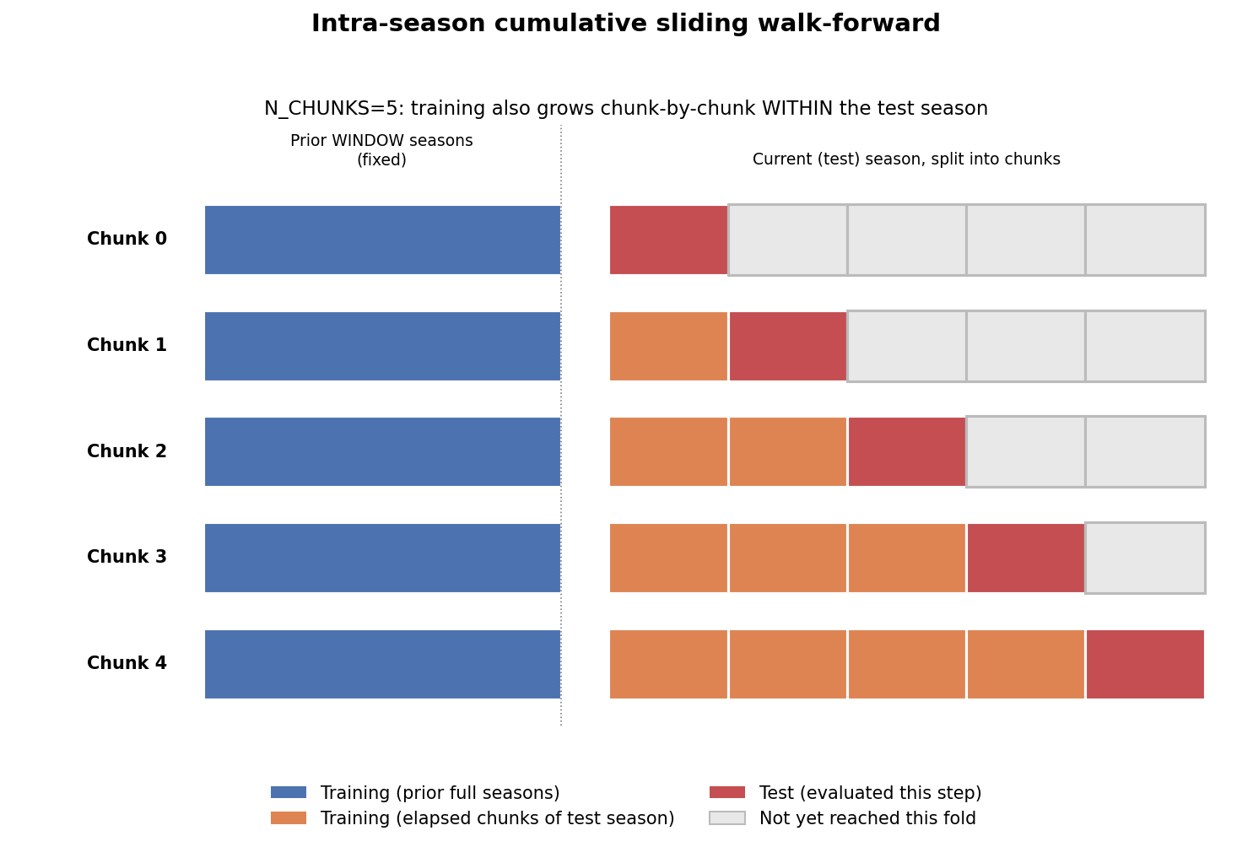
Data split
Many seasons
Walk forward CV
3 prior seasons
+ extra parts within the
season that is tested
Validation set where needed
Serving as final evaluation split

Slide 9
Evaluation methods
Full-time result
Own models vs the market odds
Best configurations
Accuracy
Log loss
Brier score

Slide 10
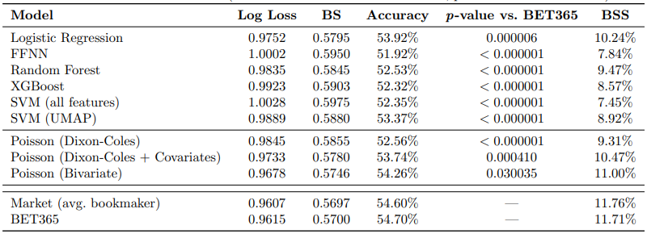
Results
Comfortably outperforming baseline
High performers:
  Logistic regression
  Dixon-Coles with
  covariates
  Bivariate Poisson
Weak performers:
  FFNN
  SVM
  XGBoost

Slide 11
Discussion & conclusion
Goal count distribution 👑
Market effectivity unbeaten
Historical data and lack of other information
Dataset size, variance and the nature of it
Difficulty of the task

Slide 12
Future research suggestions
Exploration of other model architectures
Scaling up
Novel information

